Slide 1
A Guide for updating maps in ArcGIS

Slide 2
CONTENTS OF PRESENTATION
Adding/Deleting/Changing points on map
Changing symbol style and color.
Editing story maps in ArcGIS online

Slide 3
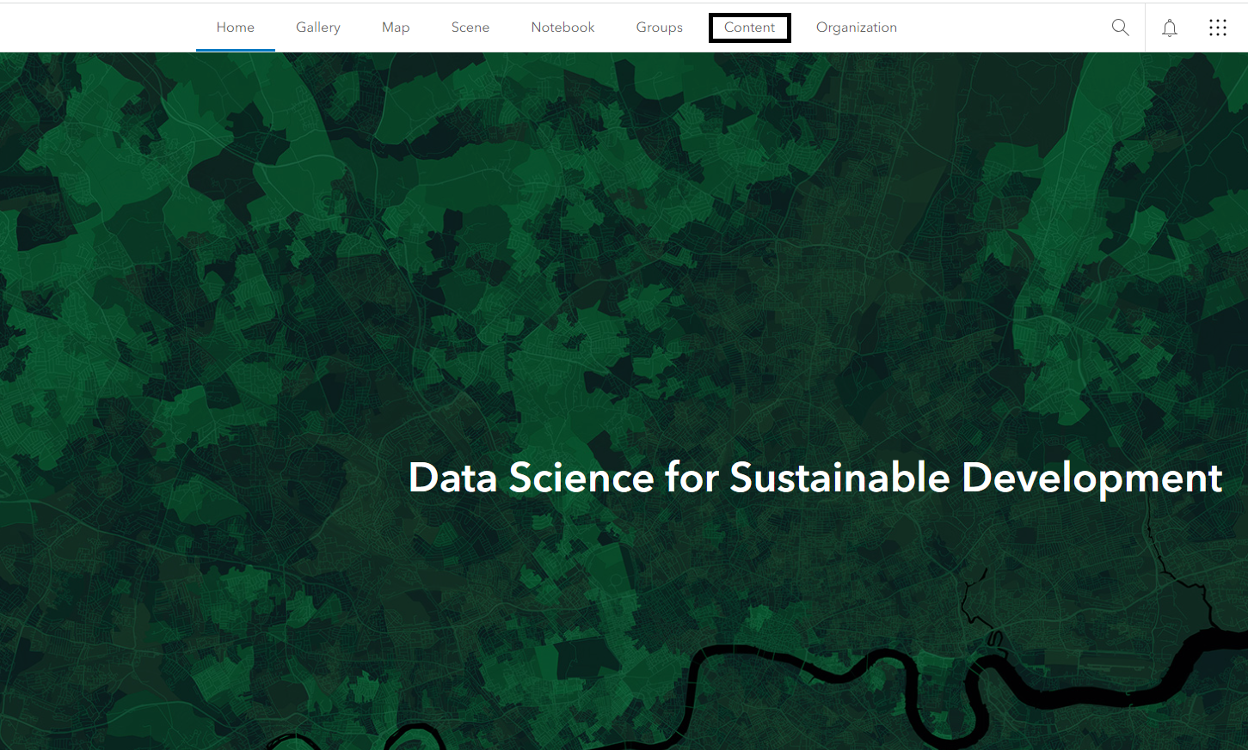
Updating CSV file in ArcGis
Adding/deleting/changing points on map
Navigate to ArcGIS Online website : https://www.arcgis.com/index.html
Enter the login credentials and login.
Once logged into ArcGIS Online, navigate to the Content tab.

Slide 4
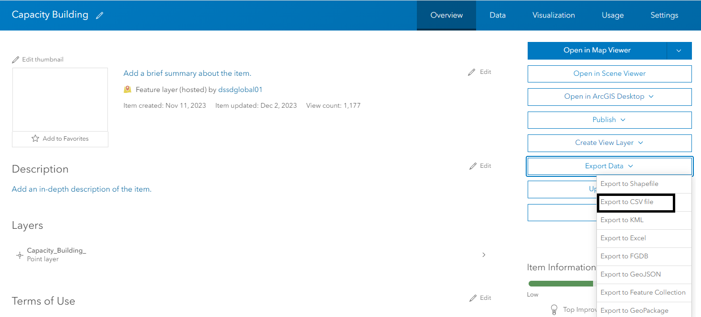
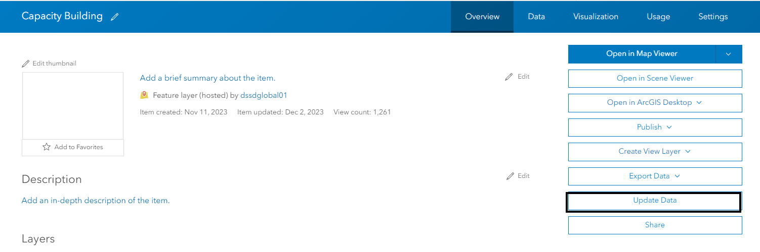
Updating CSV file in ArcGis
Select the Feature of Interest.
Select Export Data as CSV.
Update your file with the new points/remove points.
Return to the Feature Layer and select update data.

Slide 5
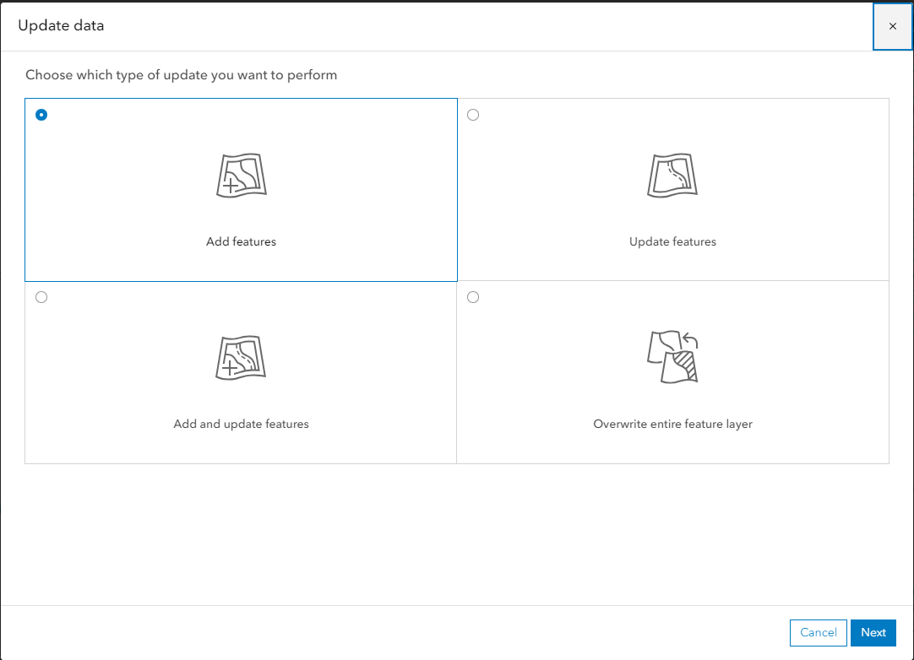
Updating CSV file in ArcGis
Select what kind of update:
Add Feature – Appending completely new point
Update Feature – Change attribute of existing feature(update link, change photo, etc)
Add and Update – Combination of adding a new point and editing existing points
Overwrite entire feature – Replace a feature, delete a feature (appending a CSV where
the point/s you want to delete are not present in the document will delete the feature)

Slide 6
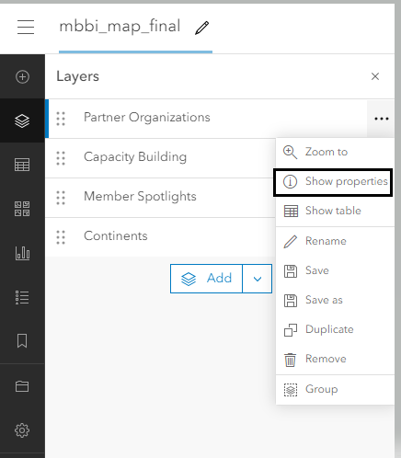
Change symbol style and symbol color
Once logged into ArcGis Online, navigate to Content tab.
Select the mbbi_map_final layer.
Open in map viewer.
Select the layer you would like to edit in contents tab and select show properties.

Slide 7
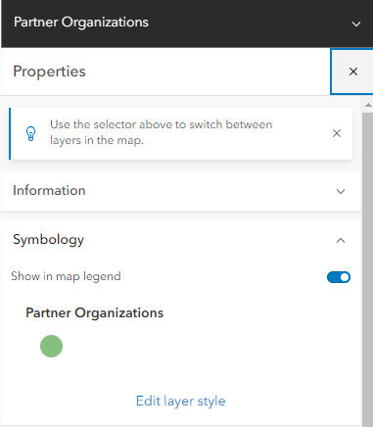
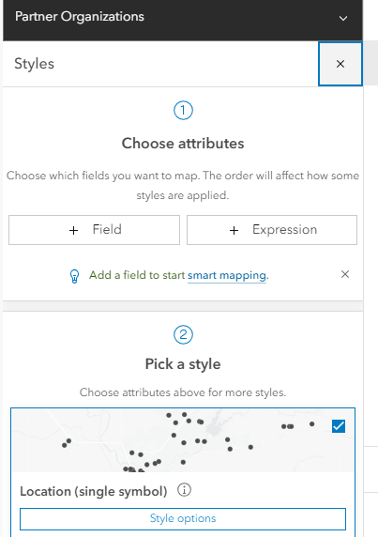
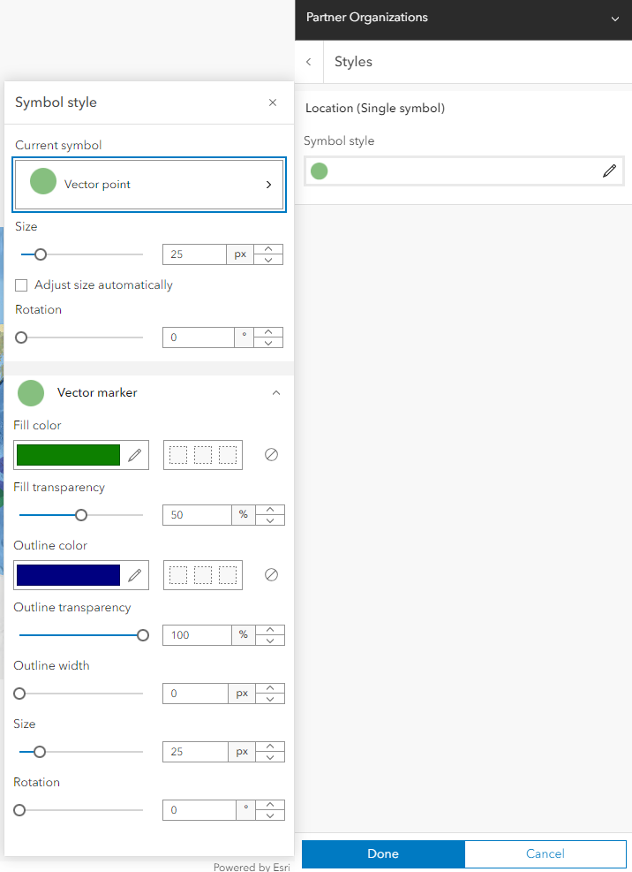
Change symbol style and symbol color
Select Edit Layer Style and configure desired setting.
Click on style options on right hand site.
Select symbol style and make edits to color and click Done.
Select the layer you would like to edit in contents tab and select show properties.

Slide 8
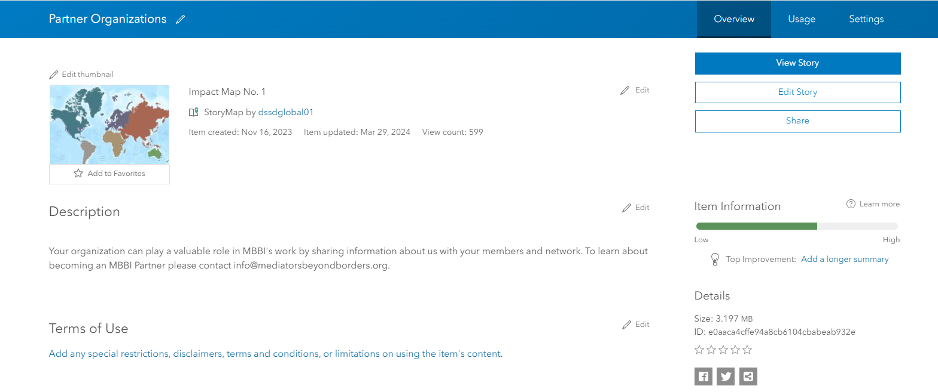
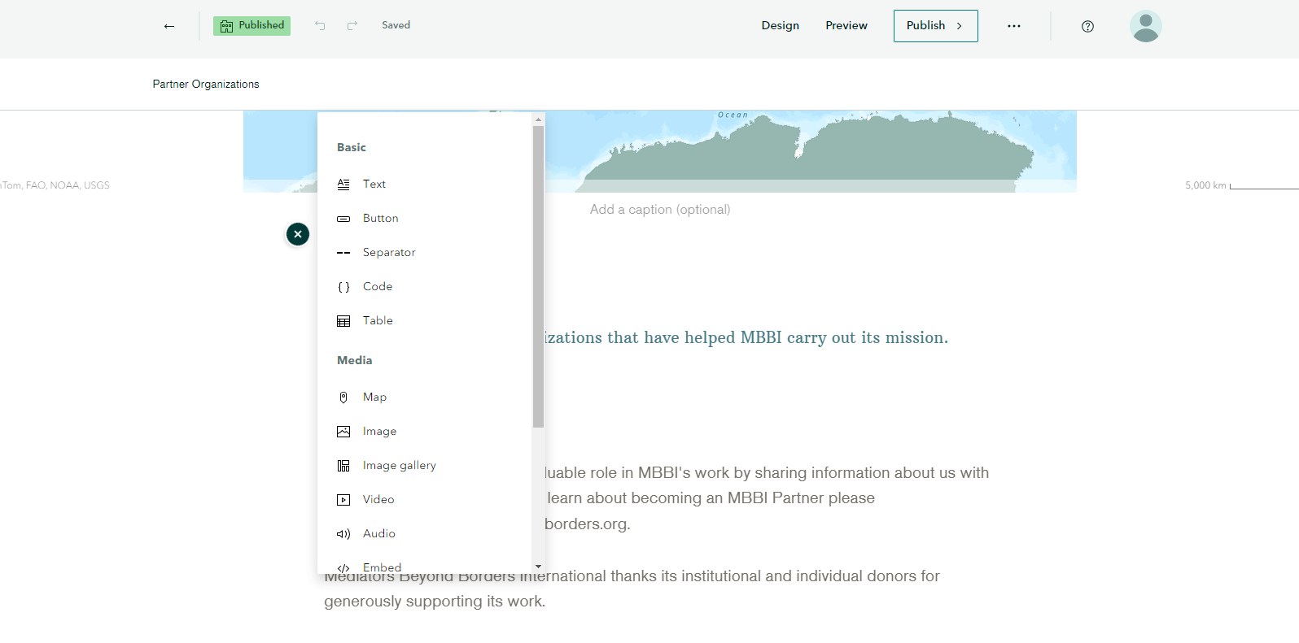
Editing Story Maps
Click on Edit Story.
Add text, tables, maps or images by selecting the appropriate option from the dropdown.

Slide 9
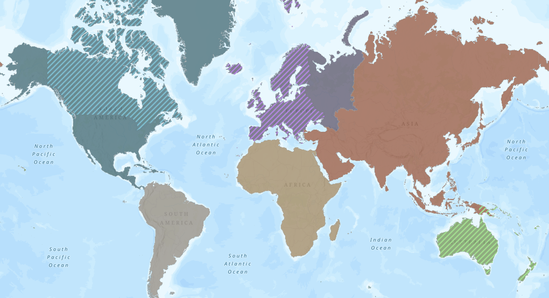
Adding to the Collaboration Regions Map
This aspect of map maintenance requires some background in GIS.
Please submit edit requests to dssd-gw@dssdglobal.org if you would like to make changes to the Collaborative Regions map. We operate during the Fall and Spring school semesters and can make changes during those periods of the year.

Slide 10
THANK YOU

